Slide 1
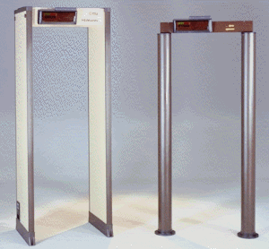
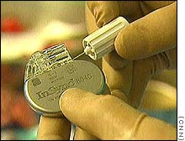
Chapter 35(36) Induction (电感) and
Magnetic properties of materials
(材料的磁性质)

Slide 2
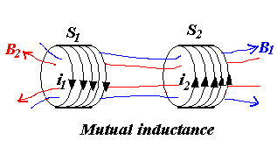
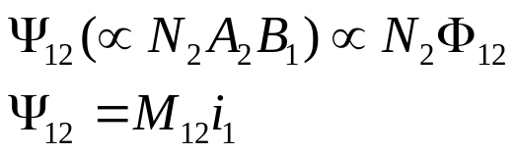
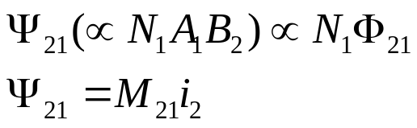
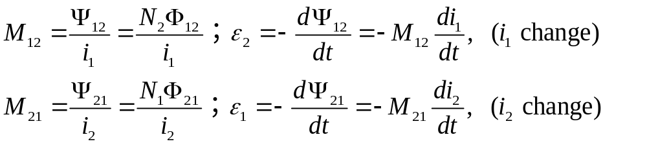
35-1 Inductance
Mutual Inductance (互感）
From Faraday’s Law
i₁ change s₂ induced emf ε₂
i₂ change s₁ induced emf ε₁
Mutual inductance emf ε₁ ε₂
The number of flux linkage (磁通匝链数) in S₂ due to S₁:
The number of flux linkage (磁通匝链数) in S₁ due to S₂:
From Faraday’s Law

Slide 3
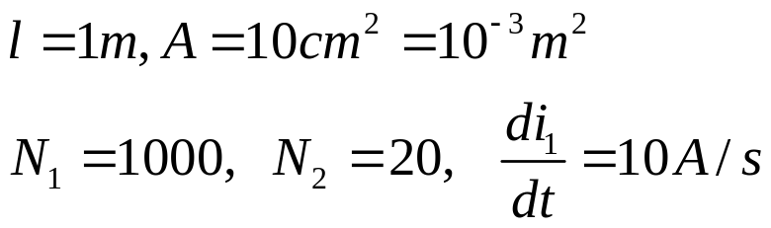
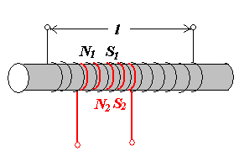
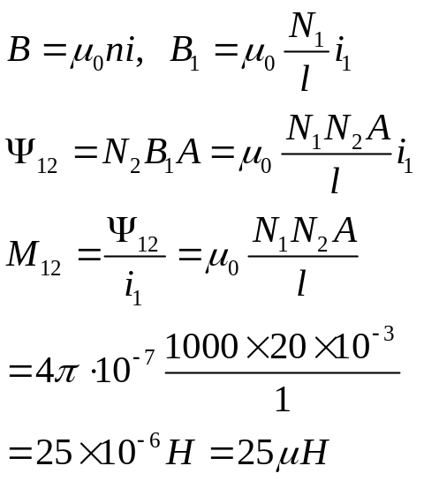
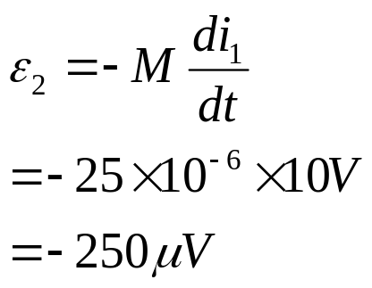
Notes
M₁₂, M₂₁ are called inductance constant (互感系数）.
M₁₂=M₂₁=M
Unit of M: Hery (亨利）H 1H=1Wb/1A, mH, μH
Example 1
Calculate Mutual inductance,
induced emf ε₂ in S₂

Slide 4
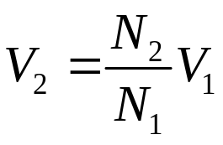
Applications of Mutual Inductance
iron
Transformers (still to come)
  Change one AC voltage into another
∼
V₁
V₂
ε
Airport Metal Detectors
  Pulsed current → pulsed magnetic field
  → Induces emf in metal
  Ferromagnetic metals “draw in” more B
  → larger mutual inductance → larger emf
  Emf → current (how much, how long it lasts, depends on the resistivity of the material)
  Decaying current produces decaying magnetic field
  → induces current in receiver coils
  Magnitude & duration of signal depends on the composition and geometry of the metal object.
N₁
N₂
(primary)
(secondary)

Slide 5
Applications of Mutual Inductance
Pacemakers(心脏起搏器)
  It’s not easy to change the battery!
  Instead, use an external AC supply.
  Alternating current
  → alternating B
  → alternating Ф_{B} inside “wearer”
  → induces AC current to power pacemaker
~

Slide 6
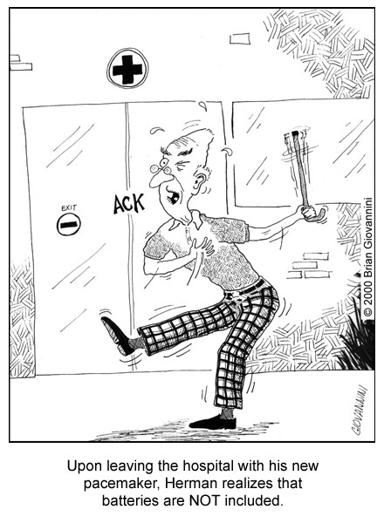
Applications of Mutual Inductance

Slide 7
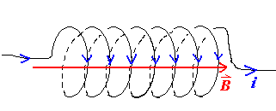
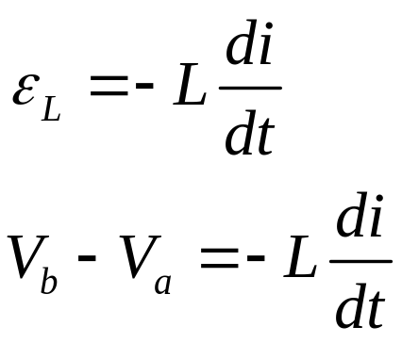
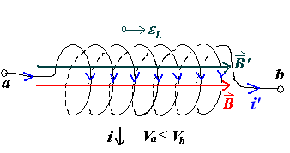
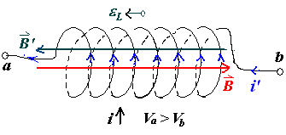
2. Self-Inductance (自感)
i change, B change
induced emf ε_{L}
L ----- self-inductance

Slide 8
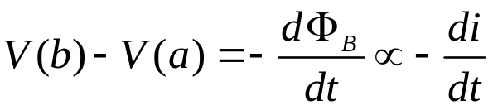
Self-Inductance
X X
X X X
X X
X X
X X X
X X
Consider the loop at the right, R_{loop}=0.
  switch closed ⇒ current starts to flow in the loop.
(is it infinite??) i = V/ 0 !!!
No. “inductance” limits di / dt
a
b
  Therefore, magnetic field produced in the area enclosed by the loop. (B proportional to i)
  Therefore, flux through loop increases as the current increases
  Therefore, emf induced in loop opposing initial direction of current flow because it opposes increasing flux (Faraday’s Law)
this emf causes V(a) > V(b) [~like a battery to oppose
the real battery – reduce current flow]
Fact: the current turns on at such a rate to give V(b)-V(a) = battery voltage:
Self-Induction: changing current through a loop inducing an opposing emf in that same loop.

Slide 9

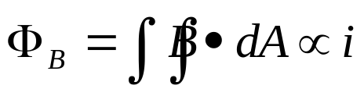
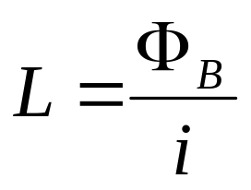
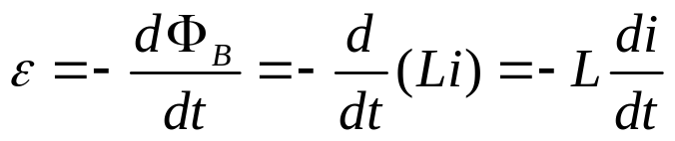
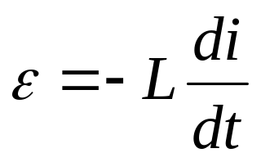
Self-Inductance
The magnetic field produced by the current in the loop shown is proportional to that current:
i
The flux, therefore, is also proportional to the current.
We define this constant of proportionality between flux and current to be the inductance, L.
Combining with Faraday’s Law gives the emf induced by a changing current:

Slide 10
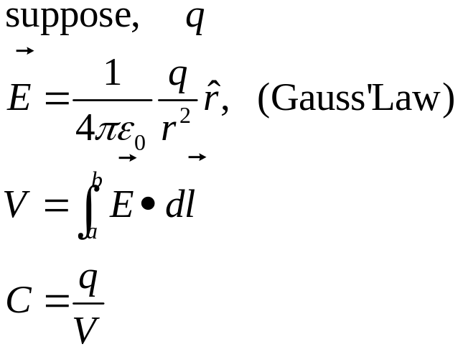
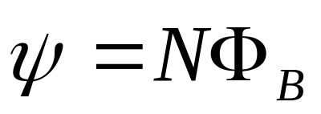
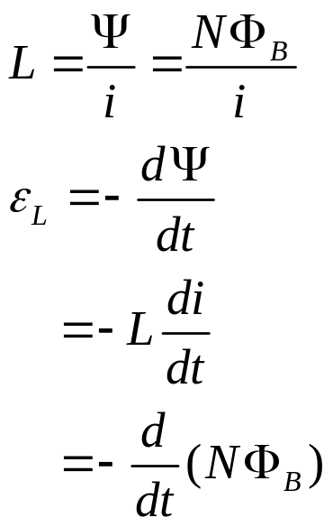
3. How to calculate the self-inductance(自感系数)
Similar to calculating the capacitance of a capacitor
Calculate L:
Suppose i in a particular inductor
Determine B
The number of flux linkages:

Slide 11
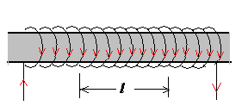
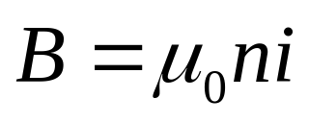
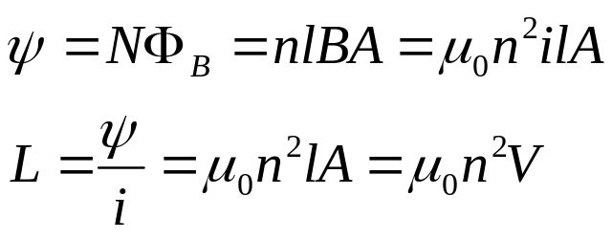
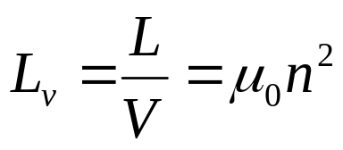
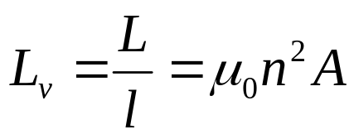
Example 2, The self-inductance of a solenoid
Calculate L for a section of length l of a long solenoid of cross-sectional area A
Suppose i in the solenoid.
The number of flux linkages:
The self-inductance per unit volume:
The self-inductance per unit length:

Slide 12
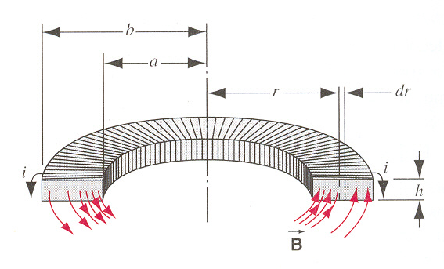
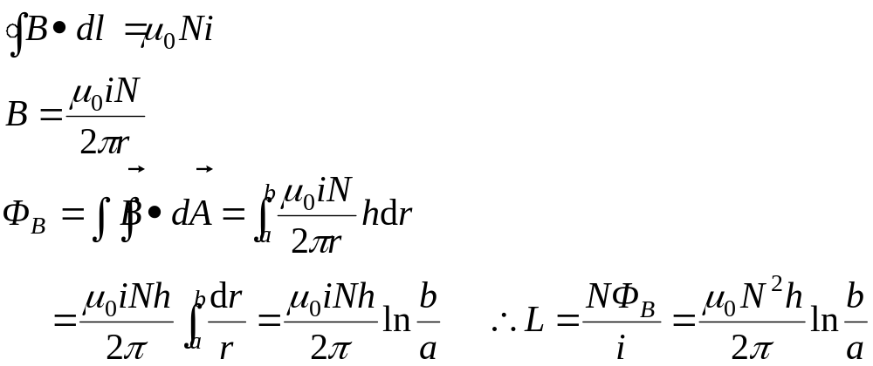
Example 3 The inductance of a Toroid of rectangular
N: the total number of turns of toroid
L depends only on the geometrical factors.

Slide 13
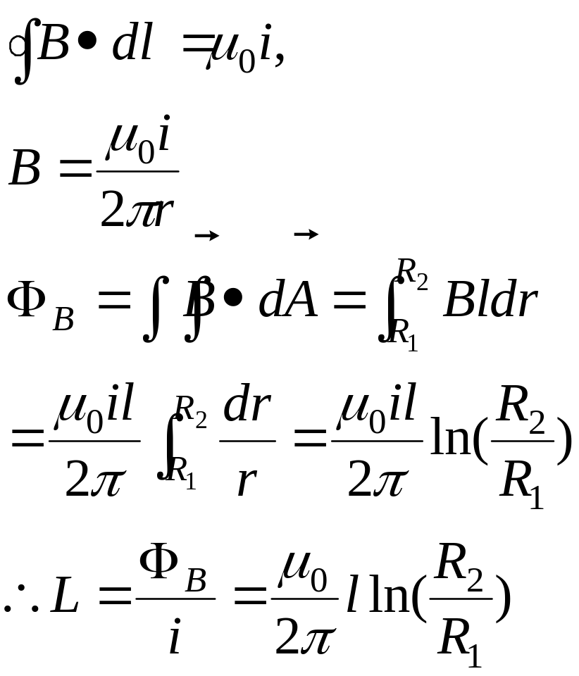
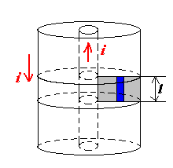
Example: TV signals transmit
(coaxial cable)
L=?

Slide 14
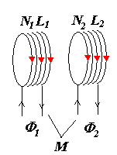
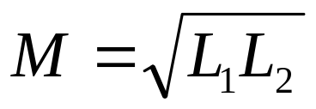
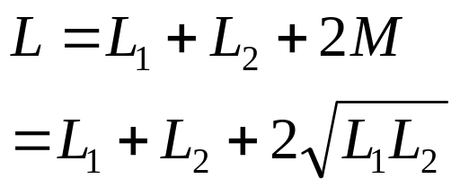
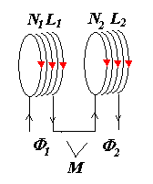
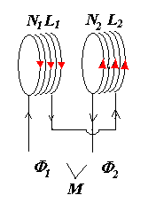
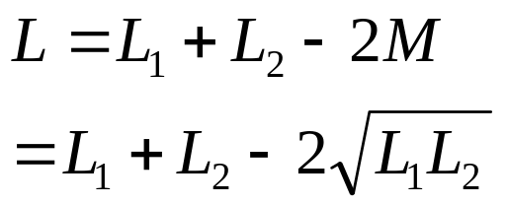
4. The relationship between mutual inductance and self inductance
No flux leakage (无漏磁)
Direct in series (顺接)
Opposite in series (反接)

Slide 15
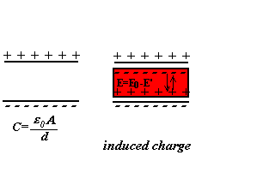
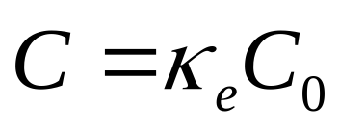
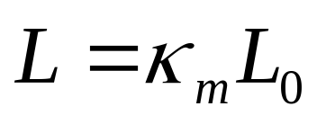
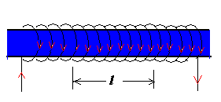
5. Inductors with magnetic material
Capacitor with dielectrics
κ_{e}: dielectric constant
inductor with magnetic material
κ_{m}: permeability constant
For paramagnetic or diamagnetic material:
κ_{m}≈ 1
For ferromagnetic material:
κ_{m}= 10³-10⁴
Magnetic Properties of materials

Slide 16
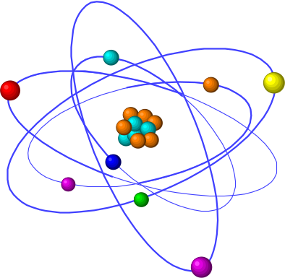
35-2 Magnetic Properties of Material
(材料的磁性质)
Orbits of electrons about nuclei
Intrinsic “spin” of electrons (more important effect)

Slide 17

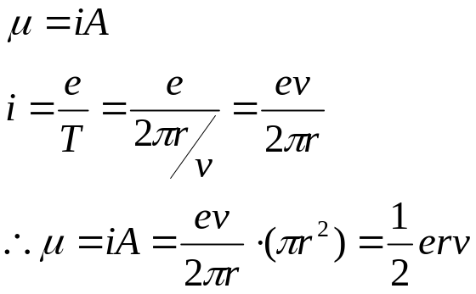
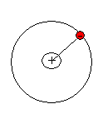
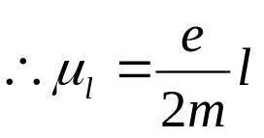
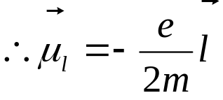

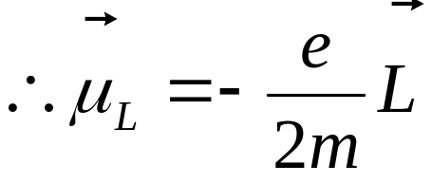
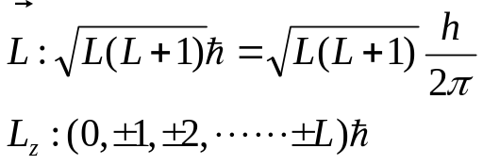

1. Atomic and nuclear magnetism
The magnetic properties is determined by the magnetic moment of the valance electrons.
Orbital magnetic moment (轨道磁矩)
The magnetic dipole moment:
The angular momentum:
The magnetic dipole moment in vector :
L: The total angular momentum of all electrons in atom.
μ_{L}: The total magnetic moment of all electrons in atom.
The smallest unit of μ_{L}
Quantum Mechanism:

Slide 18






The spin magnetic dipole moment
(自旋磁矩)
Elementary particles: intrinsic angular momentum (自旋角动量) S
For Example:
Intrinsic magnetic dipole moment :
The total intrinsic magnetic dipole moment:
The total spin of all electrons in the atom:
The magnetic properties of material are determined by the magnetic dipole moment of its atoms.

Slide 19


Nuclear Magnetism
(原子核磁性)
Protons+Neutrons=Nuclear
Orbital part: Proton μ_{pl}=0,
Neutron μ_{nl}=0
Spin part: Proton μ_{ps}=0
Neutron: μ_{ns}=0

Slide 20






2. Magnetization (磁化强度) of material
Soft-Fe rod (软铁棒)
The macroscopic result:
Induced Current
(束缚电流)

Slide 21







Magnetization Vector (磁化强度矢量)
Define magnetization Vector
Induced current density（束缚电流密度）
Show:
Uniform magnetization:
Polarization:

Slide 22




Non-uniform magnetization:

Slide 23






Ampere’s Loop Law with magnetic material
The magnetic induction strength in the magnetic medium
Define magnetic field strength (磁场强度）
New Ampere’s Loop Law
Gauss’ Law
Because Biot-Savart Law for i and i’ is always value.

Slide 24





Notes for magnetic field strength H
Define magnetic field strength (磁场强度）
Unit of H: Os, A/m
1A/m=4π×10⁻³Os
In vacuum
For a solenoid with soft-Fe rod:

Slide 25






3. The magnetization Law for material
Relationship between M, B and H
For dielectrics:
For magnetic materials:
χ_{m}: susceptibility (磁化率)
magnetization coefficient
κ_{m}: permeability constant (磁导率)
For a solenoid with soft-Fe rod:

Slide 26




Notes for χ_{m} , κ_{m}
For dielectrics:
For magnetic materials:
Paramagnetic（顺磁）materials:
Diamagnetic（抗磁）materials:
Ferromagnetic（铁磁）materials:
Paramagnetic materials(18ºC)
Diamagnetic materials (18ºC)
Mn χ_{m}=12.4×10⁻⁵
Cr 4.5×10⁻⁵
Al 0.82×10⁻⁵
Air 30.36×10⁻⁵
Bi χ_{m}=-1.70×10⁻⁵
Cu -0.108×10⁻⁵
Ag -0.25×10⁻⁵
H -2.47×10⁻⁵

Slide 27





Microscopic Explanation
For paramagnetic materials:
The temperature dependence
Curie Law

Slide 28







2. For diamagnetic materials
ω B
ω -B

Slide 29






3.Ferromagnetic materials
+ strong interaction between neighboring atomic dipole moments
Fe, Co, Ni at room temperature
Gd, Dy at low temerature
CrO₂ the magnetic powder on the tape.
T , Ferromagnetic paramagnetic
the interaction
Curie-Weiss Law
Magnetic hysteresis:
Domain(磁畴)

Slide 30



Ferromagnets, cont.
Even in the absence of an applied B, the dipoles tend to strongly align over small patches – “domains (磁畴)”. Applying an external field, the domains align to produce a large net magnetization.
“Soft” ferromagnets
  The domains re-randomize when the field is removed
“Hard” ferromagnets
  The domains persist even when the field is removed
  “Permanent” magnets
    Domains may be aligned in a different direction by applying a new field
    Domains may be re-randomized by sudden physical shock
    If the temperature is raised above the “Curie point” (770˚ for iron), the domains will also randomize → paramagnet
Magnetic
Domains

Slide 31






35-3 RL Circuits
RC circuits:
K closed
RL circuits:
K a
Induct time constant

Slide 32





RL Circuit (ε on)
L/R
2L/R
Sketch curves !
Current
Max = ε/R
63% Max at t=L/R
ε/R
i
0
t
Voltage on L
Max = ε/R
37% Max at t=L/R
ε
V_{L}
0
t

Slide 33



RL Circuits
After the switch has been in position a for a long time, redefined to be t=0, it is moved to position b.
Loop law:
The appropriate initial condition is
The solution then must
have the form:

Slide 34


RL Circuit (ε off)
L/R
2L/R
Sketch curves !
Current
Max = ε/R
37% Max at t=L/R
ε/R
i
0
t
0
Voltage on L
Max = -ε
37% Max at t=L/R
V_{L}
-ε
t

Slide 35





ε on ε off
L/R
2L/R
L/R
2L/R
ε/R
ε/R
i
i
0
0
t
t
ε
0
V_{L}
V_{L}
0
-ε
t
t

Slide 36




35-4 Energy storage in a magnetic field
In Capacitor:
The energy density in electric field
1. The magnetic energy in a self-inductance L:
i: 0 i_{max}
The work done by the seat:
Energy is stored in the magnetic field in the solenoid.

Slide 37



2. The magnetic energy stored in two solenoid
The work done by the source for interacting inductance M:
S₁: 0 I₁
S₂: 0 I₂
The total magnetic energy in two solenoids:
The total magnetic energy in k solenoids:

Slide 38





3. Energy density in a magnetic field: u_{B}
Consider a long solenoid of cross-section area A:
The magnetic energy density:
The electric field energy density:

Slide 39


Notes
Although this equation is derived from a solenoid, the equation gives the energy density stored at any point (in a vacuum or in a nonmagnetic substance) where the magnetic field B.
Symmetry:

Slide 40






Example 36-6 page 829
Calculate the energy stored in the magnetic field for a length l of such a cable.
What is the inductance of a length l of the cable?

Slide 41





Example 36-7 page 830
Compare the energy required to set up, in a cube l=10cm on edge. (a) a uniform electric field of 1.0×10⁵V/m, (b) a uniform magnetic field B=1.0Tesla.

Slide 42
Homework
Page 839 (Exercises) 14
Page 842 (Problems) 2, 3, 8
Page 818 (Exercises) 7, 10
Page 820 (Problem) 1, 3, 4,

Slide 43

35-5 Electromagnetic Oscillation
(电磁振荡）
LC Circuits:

Slide 44






Analogy to Simple Harmonic Motion

Slide 45






Electromagnetic Oscillations: Quantitative
The total energy of a ideal electromagnetic oscillator is conserved.
The phase constant ϕ is determined by the conditions at t=0.

Slide 46




Damped and Forced oscillations
(阻尼和受拍振动)
If there are resistances in circuit, the U is no longer constant.
RLC circuits
Over-damped
(过阻尼)

Slide 47



Over-damped (过阻尼)
Charging
Discharging

Slide 48





2) Critical-Damped(临界阻尼)
Charging
Discharging

Slide 49




3)Damped Oscillation (阻尼振荡)

Slide 50



Forced Oscillations and Resonance
(受拍振动和共振)
When ω”=ω,
i_{m} exhibits a maximum

